Slide 1
Graph
Dr. Inayat-ur-Rehman
COMSATS Institute of Information Technology,
Islamabad

Slide 2
What is a Graph?
A graph G = (V,E) is composed of:
V: set of vertices
E: set of edges connecting the vertices in V
An edge e = (u,v) is a pair of vertices
Example:
a
b
V= {a,b,c,d,e}
E= {(a,b),(a,c),(a,d),
(b,e),(c,d),(c,e),
(d,e)}
c
d
e

Slide 3
Applications
electronic circuits
networks (roads, flights, communications)
CS16
Abbott
LAX
Haripur
Islamabad
Lahore
Taxila
khanpur

Slide 4

Definition of Graphs
A graph is a finite set of nodes with edges between nodes
Formally, a graph G is a structure (V,E) consisting of
  a finite set V called the set of nodes, and
  a set E that is a subset of VxV. That is, E is a set of pairs of the form (x,y) where x and y are nodes in V

Slide 5
Examples of Graphs
V={0,1,2,3,4}
E={(0,1), (1,2), (0,3), (3,0), (2,2), (4,3)}
1
When (x,y) is an edge,
we say that x is adjacent to y, and y is adjacent from x.
0 is adjacent to 1.
1 is not adjacent to 0.
2 is adjacent from 1.
0
2
4
3

Slide 6
A “Real-life” Example of a Graph
V=set of 6 people: John, Mary, Joe, Helen, Tom, and Paul, of ages 12, 15, 12, 15, 13, and 13, respectively.
E ={(x,y) | if x is younger than y}
Mary
Helen
John
Joe
Tom
Paul

Slide 7
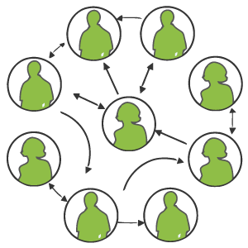
Graph examples
For each, what are the vertices and what are the edges?
  Web pages with links
  Methods in a program that call each other
  Road maps (e.g., Google maps)
  Airline routes
  Facebook friends
  Course pre-requisites
  Family trees
  Paths through a maze

Slide 8

Intuition Behind Graphs
The nodes represent entities (such as people, cities, computers, words, etc.)
Edges (x,y) represent relationships between entities x and y, such as:
  “x loves y”
  “x hates y”
  “x is a friend of y” (note that this not necessarily reciprocal)
  “x considers y a friend”
  “x is a child of y”
  “x is a half-sibling of y”
  “x is a full-sibling of y”
In those examples, each relationship is a different graph

Slide 9
Graph Terminology
Reachable: Vertex a is reachable from b
if a path exists from a to b.
Connected: A graph is connected if every
vertex is reachable from any other.
  Is the graph at top right connected?
Strongly connected: When every vertex
has an edge to every other vertex.
V
a
b
U
d
X
Z
h
c
e
W
g
f
Y
a
b
a
b
d
c
e
c
d

Slide 10
Loops and cycles
cycle: A path that begins and ends at the same node.
  example: {b, g, f, c, a} or {V, X, Y, W, U, V}.
  example: {c, d, a} or {U, W, V, U}.
  acyclic graph: One that does
  not contain any cycles.
loop: An edge directly from
a node to itself.
  Many graphs don't allow loops.
V
a
b
U
d
X
Z
h
c
e
W
g
f
Y

Slide 11
Terminology:
Degree of a Vertex
The degree of a vertex is the number of edges incident to that vertex
For directed graph,
  the in-degree of a vertex v is the number of edges
  that have v as the head
  the out-degree of a vertex v is the number of edges
  that have v as the tail

Slide 12
Weighted graphs
weight: Cost associated with a given edge.
  Some graphs have weighted edges, and some are unweighted.
  Edges in an unweighted graph can be thought of as having equal weight (e.g. all 0, or all 1, etc.)
  Most graphs do not allow negative weights.
example: graph of airline flights, weighted by miles between cities:
849
PVD
1843
ORD
142
SFO
802
LGA
337
1743
1387
HNL
2555
1099
LAX
1233
DFW
1120
MIA

Slide 13
Examples
0
3
2
0
1
2
3
3
3
1
2
3
3
4
5
6
G1
1
1
1
3
G2
1
3
0
in:1, out: 1
directed graph
in-degree
out-degree
1
in: 1, out: 2
2
in: 1, out: 0
G3

Slide 14
Terminology:
Path
path: sequence of vertices v₁,v₂,. . .v_{k} such that consecutive vertices v_{i} and v_{i+1} are adjacent.
3
2
3
3
3
a
b
a
b
c
c
d
e
d
e
a b e d c
b e d c

Slide 15
Graphs: Example
1
6
2
3
7
4
5
8
Legend
Directional path
Bi-directional paths

Slide 16
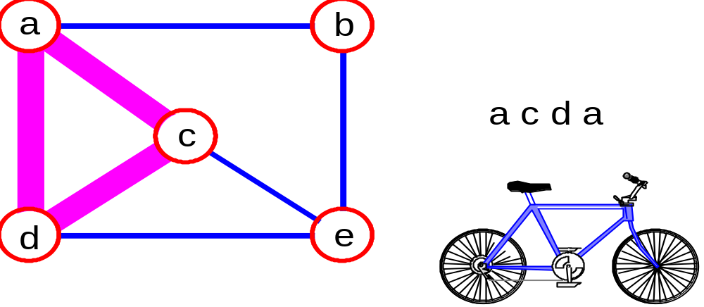
More Terminology
simple path: no repeated vertices
cycle: simple path, except that the last vertex is the same as the first vertex
a
b
b e c
c
d
e

Slide 17
Even More Terminology
connected graph: any two vertices are connected by some path
connected
not connected
subgraph: subset of vertices and edges forming a graph
connected component: maximal connected subgraph. E.g., the graph below has 3 connected components.

Slide 18
Graph Representations
Adjacency Matrix
Adjacency Lists

Slide 19
Adjacency Matrix Representation
In this representation, each graph of n nodes is represented by an n x n matrix A, that is, a two-dimensional array A
The nodes are (re)-labeled 1,2,…,n
A[i][j] = 1 if (i,j) is an edge
A[i][j] = 0 if (i,j) is not an edge

Slide 20
Example of Adjacency Matrix
1
0
0 1 0 1 0
0 0 1 0 0
0 0 1 0 0
1 0 0 0 0
0 0 0 4 0
A =
2
4
3

Slide 21
Adjacency Matrix
Let G=(V,E) be a graph with n vertices.
The adjacency matrix of G is a two-dimensional
n by n array, say adj_mat
If the edge (vi, vj) is in E(G), adj_mat[i][j]=1
If there is no such edge in E(G), adj_mat[i][j]=0
The adjacency matrix for an undirected graph is symmetric; the adjacency matrix for a digraph
need not be symmetric

Slide 22
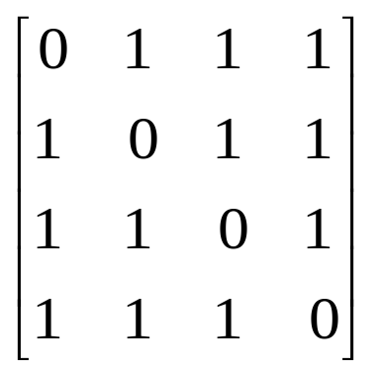
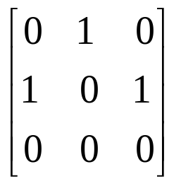
Examples for Adjacency Matrix
0
0
1
2
3
1
2
G2
G1

Slide 23
Searching for paths
Searching for a path from one vertex to another:
  Sometimes, we just want any path (or want to know there is a path).
  Sometimes, we want to minimize path length (# of edges).
  Sometimes, we want to minimize path cost (sum of edge weights).
What is the shortest path from MIA to SFO?
Which path has the minimum cost?
$50
PVD
$70
ORD
SFO
$200
$130
$60
$170
$80
LGA
$140
HNL
$250
LAX
$120
$100
DFW
$110
MIA
$500

Slide 24
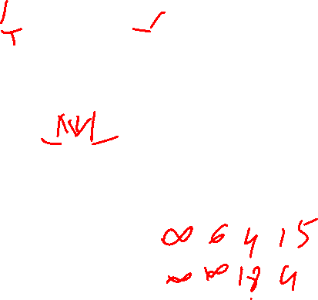
Examples for Adjacency Matrix with weight
0
6
4
18
1
2
15
4
2
3
G1

Slide 25
Another Example of Adj. Matrix
Re-label the nodes with numerical labels
Mary 0
Helen 1
0 0 0 0 0 0
0 0 0 0 0 0
1 1 0 0 1 1
1 1 0 0 1 1
1 1 0 0 0 0
1 1 0 0 0 0
A =
Joe 3
John 2
Tom 4
Paul 5

Slide 26
Pros and Cons of Adjacency Matrices
Pros:
  Simple to implement
  Easy and fast to tell if a pair (i,j) is an edge: simply check if A[i][j] is 1 or 0
Cons:
  No matter how few edges the graph has, the matrix takes O(n²) in memory

Slide 27
Pros and Cons of Adjacency List
0
1
2
3
0
1
2
3
0
2
3
1
2
0
1
3
3
0
1
2
G1
0
0
1
2
1
0
2
1
G3
2
An undirected graph with n vertices and e edges ==> n head nodes and 2e list nodes

Slide 28
Example of Linked Representation
L[0]: empty
L[1]: empty
L[2]: 0, 1, 4, 5
L[3]: 0, 1, 4, 5
L[4]: 0, 1
L[5]: 0, 1
Mary 0
Helen 1
Joe 3
John 2
Tom 4
Paul 5

Slide 29
Pros and Cons of Adjacency Lists
Pros:
  Saves on space (memory): the representation takes as many memory words as there are nodes and edge.
Cons:
  It can take up to O(n) time to determine if a pair of nodes (i,j) is an edge: one would have to search the linked list L[i], which takes time proportional to the length of L[i].

Slide 30
Single-Source Shortest Paths
We wish to find the shortest route between Islamabad and A bbottabad. Given a road map with all the possible routes how can we determine our shortest route?
We could try to enumerate all possible routes.

Slide 31
The distance of a shortest path
  Case: The graph may have negative edges but no negative cycles. The shortest distance from s to t can be computed.
s
1
8
t
d(s,t)=6
A
B
-3

Slide 32
Shortest Path Algorithms
Dijkstra’s algorithm does NOT allow negative edges.

Slide 33
Dijkstra’s shortest path algorithm
Dijkstra’s algorithm solves the single source shortest path problem in 2 stages.
  Stage1: A greedy algorithm computes the shortest distance from s to all other nodes in the graph and saves a data structure.
  Stage2 : Uses the data structure for finding a shortest path from s to t.

Slide 34
Main idea
Assume that the shortest distances from the starting node s to the rest of the nodes are
  d(s, s) ≤ d(s, s₁) ≤ d(s, s₂) ≤ … ≤ d(s, s_{n-1})
In this case a shortest path from s to s_{i} may include any of the vertices {s₁, s₂ … s_{i-1}} but cannot include any s_{j} where j > i.
Dijkstra’s main idea is to select the nodes and compute the shortest distances in the order s, s₁, s₂ ,…, s_{n-1}

Slide 35
Example
s₄
  d(s, s) =0 ≤
  d(s, s₁)=5 ≤
  d(s, s₂)=6 ≤
  d(s, s₃)=8 ≤
  d(s, s₄)=15
15
8
s₃
2
10
s
3
4
s₂
5
Note: The shortest path from s to s₂ includes s₁ as an intermediate node but cannot include s₃ or s₄.
s₁
1

Slide 36
Dijkstra’s greedy selection rule
Assume s₁, s₂ … s_{i-1} have been selected, and their shortest distances have been stored in Solution
Select node s_{i} and save d(s, s_{i}) if s_{i} has the shortest distance from s on a path that may include only s₁, s₂ … s_{i-1} as intermediate nodes. We call such paths special
To apply this selection rule efficiently, we need to maintain for each unselected node v the distance of the shortest special path from s to v, D[v].

Slide 37
Application Example
Solution = {(s, 0)}
D[s₁]=5 for path [s, s₁]
D[s₂]= ∞ for path [s, s₂]
D[s₃]=10 for path [s, s₃]
D[s₄]=15 for path [s, s₄].
Solution = {(s, 0), (s₁, 5) }
D[s₂]= 6 for path [s, s₁, s₂]
D[s₃]=9 for path [s, s₁, s₃]
D[s₄]=15 for path [s, s₄]
Solution = {(s, 0), (s₁, 5), (s₂, 6) }
D[s₃]=8 for path [s, s₁, s₂, s₃]
D[s₄]=15 for path [s, s₄]
Solution = {(s, 0), (s₁, 5), (s₂, 6),(s₃, 8), (s₄, 15) }
s₄
15
8
s₃
2
10
s
3
4
s₂
5
s₁
1

Slide 38
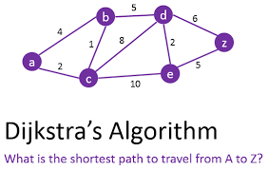

Slide 39
Graph Traversal Techniques
http://www.btechsmartclass.com/data_structures/graph-traversal-bfs.html

Slide 40
Graph Traversal Techniques
The previous connectivity problem, as well as many other graph problems, can be solved using graph traversal techniques
There are two standard graph traversal techniques:
  Depth-First Search (DFS)
  Breadth-First Search (BFS)

Slide 41
Graph Traversal (Contd.)
In both DFS and BFS, the nodes of the undirected graph are visited in a systematic manner so that every node is visited exactly one.
Both BFS and DFS give rise to a tree:
  When a node x is visited, it is labeled as visited, and it is added to the tree
  If the traversal got to node x from node y, y is viewed as the parent of x, and x a child of y

Slide 42
Depth-First Search
DFS follows the following rules:
  Select an unvisited node x, visit it, and treat as the current node
  Find an unvisited neighbor of the current node, visit it, and make it the new current node;
  If the current node has no unvisited neighbors, backtrack to the its parent, and make that parent the new current node;
  Repeat steps 3 and 4 until no more nodes can be visited.
  If there are still unvisited nodes, repeat from step 1.

Slide 43
Illustration of DFS
0
1
0
2
1
4
4
9
10
5
7
2
11
8
5
9
6
7
11
6
Graph G
8
10
DFS Tree

Slide 44
Implementation of DFS
Observations:
  the last node visited is the first node from which to proceed.
  Also, the backtracking proceeds on the basis of "last visited, first to backtrack too".
  This suggests that a stack is the proper data structure to remember the current node and how to backtrack.

Slide 45
Illustrate DFS with a Stack
We will redo the DFS on the previous graph, but this time with stacks

Slide 46
DFS (Pseudo Code)
DFS(input: Graph G) {
Stack S; Integer x, t;
while (G has an unvisited node x){
visit(x); push(x,S);
while (S is not empty){
t := peek(S);
if (t has an unvisited neighbor y){ visit(y); push(y,S); }
else
pop(S);
}
}
}

Slide 47
Breadth-First Search
BFS follows the following rules:
  Select an unvisited node x, visit it, have it be the root in a BFS tree being formed. Its level is called the current level.
  From each node z in the current level, in the order in which the level nodes were visited, visit all the unvisited neighbors of z. The newly visited nodes from this level form a new level that becomes the next current level.
  Repeat step 2 until no more nodes can be visited.
  If there are still unvisited nodes, repeat from Step 1.

Slide 48
Illustration of BFS
0
1
0
2
4
2
1
4
9
5
9
10
10
5
7
11
8
6
7
8
11
6
BFS Tree
Graph G

Slide 49
Implementation of DFS
Observations:
  the first node visited in each level is the first node from which to proceed to visit new nodes.
This suggests that a queue is the proper data structure to remember the order of the steps.

Slide 50
Illustrate BFS with a Queue
We will redo the BFS on the previous graph, but this time with queues

Slide 51
BFS (Pseudo Code)
BFS(input: graph G) {
Queue Q; Integer x, z, y;
while (G has an unvisited node x) {
visit(x); Enqueue(x,Q);
while (Q is not empty){
z := Dequeue(Q);
for all (unvisited neighbor y of z){ visit(y); Enqueue(y,Q);
}
}
}
}

Slide 52
DFS vs. BFS
DFS Process
F
B
A
start
E
G
D
C
destination
C
DFS on C
D
Call DFS on D
B
DFS on B
B
B
Return to call on B
A
DFS on A
A
A
A
G
Call DFS on G
found destination - done!
Path is implicitly stored in DFS recursion
Path is: A, B, D, G
D
B
A

Slide 53
DFS vs. BFS
F
B
A
start
E
BFS Process
G
D
C
destination
rear
front
rear
front
rear
front
rear
front
A
B
D
C
D
Initial call to BFS on A
Add A to queue
Dequeue A
Add B
Dequeue B
Add C, D
Dequeue C
Nothing to add
rear
front
G
found destination - done!
Path must be stored separately
Dequeue D
Add G

Slide 54
Reference
Rada Mihalcea
John Lewis and William Loftus
Data structure through C in depth
Data Structure through C

